Slide 1

X. Conference
of functional examinations of the lungs
SNIP
for assessment of inspiratory muscle strength
Hans-Jürgen Smith, Berlin, Germany
Zlín 20th – 21st May 2022

Slide 2
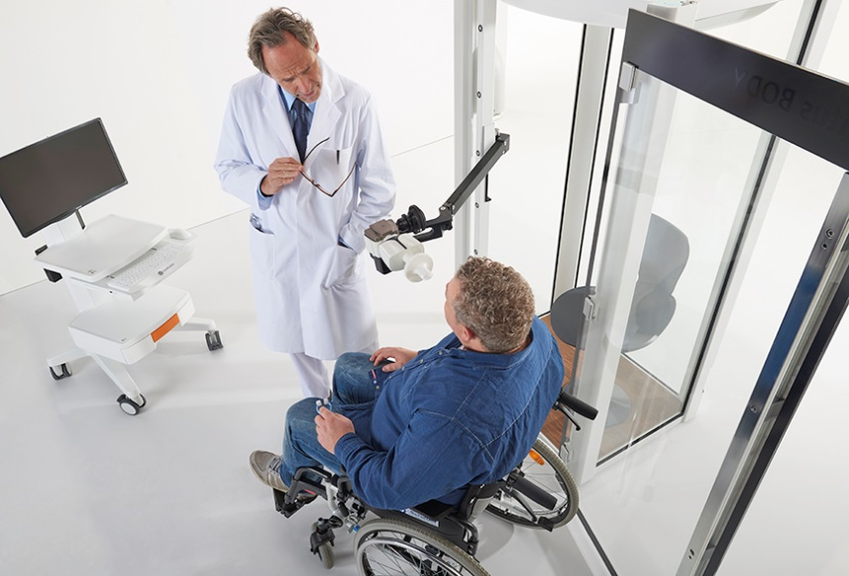
Sniff Nasal Inspiratory Pressure SNIP
Maximal sniff nasal inspiratory pressure (SNIP) is a sensitive test to early disclose respiratory muscle decline.

Slide 3
Sniff Nasal Inspiratory Pressure
Method
Placement
The Sniff Nasal Inspiratory Pressure (SNIP) is an alternative measurement to the classic volitional static test of inspiratory muscle strength, which is Maximum Inspiratory Pressure (MIP / PImax).
i
A sniff manoeuver is more natural and easier to perform than static efforts for most subjects.
!
  Careful quality check to drastically reduce over-diagnosis of muscle weakness!

Slide 4
Sniff Nasal Inspiratory Pressure
Physiology and limitations
  During a vigorous sniff, the nasal valve of the patent’s nostril collapses and the pressure beyond the collapsed segment closely reflects oesophageal pressure and therefore inspiratory muscle strength.
!
Limitations that lead to under-diagnosis
  Severe nasal congestion
    Hinders pressure transmission
    Leads to falsely low values
  Severe or acute airflow limitation
    Underestimation of SNIP pressure in acute asthma (15%) or COPD (20%)

Slide 5
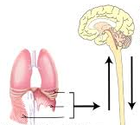
Indications for SNIP
ATS/ERS Statement to the diagnosis of the breathing pump
Breathing pump
  Breathing centre
  Conducting nerves
  Thoracic wall and inspiratory muscles
  Bony thorax
Fatigue or failure of inspiratory muscles stands for:
  A potentially threatening condition
  Imbalance between muscle load and capacity
  In severe case – hypercapnic respiratory failure
  Impaired cough and airway clearance
  Risk for lung atelectasis and infection
  Acute respiratory failure in neuromuscular disorders
  Restrictive pattern in lung volumes or spirometry
  Association to long-term mortality in cardiovascular disease or COPD
  See indications of MIP (PImax)
ATS/ERS Statement on Respiratory Muscle Testing. Am J Respir Crit Care Med. Vol 166; 2002: 518-624

Slide 6
Sniff Nasal Inspiratory Pressure
Background and methodology
SNIP measurement - background
  Non-invasive test
  No need of a mouthpiece
  Natural and easy manoeuver
  During sniff
    Strong activation of diaphragm and scalene muscles
    Reliable assessment of diaphragm strength
  Often used as alternative to the MIP (PImax) measurement
i
  SNIP is an accurate and non-invasive approximation of the oesophageal pressure swing during sniff manoeuvres.
Methodology
Measurement of peak nasal pressure at one occluded nostril during a short maximal sniff performed from relaxed end-inspiration (FRC) through the contralateral nostril.
The mouth is closed.

Slide 7
Clinical application
Preparations and test procedure / instructions
Preparations
Patient in sitting position.
One nostril occluded with a nasal plug connected to the
pressure transducer via silicon tube.
Contralateral nostril is open, mouth closed.
Test procedure
After normal tidal breathing the subject performs a sharp and maximal sniff from end-expiratory level (FRC).
Target parameter: SNIPpeak
After 5-7 trials a plateau in SNIPpeak values should be visible.
Up to 15 to 30 s pause between trials.
Pressure [kPa]
SNIPpeak
16
12
8
4
SNIP target parameter
SNIPpeak | Sniff nasal inspiratory peak pressure
!
  SNIPavg and SNIPsus not recommended.

Slide 8
Reference values
Adults and children
Reference values
Children: Stefanutti (6-17) Adults: Uldry (20-80)
  SNIP is similar in adults and children
  Nearly age independent
!
  SNIP in healthy subjects is often higher than MIP.
  Limits of agreement between SNIP and MIP.
      SNIP and MIP are NOT interchangeable.
      Complementary information.
D.Stefanutti et al. Sniff Nasal Inspiratory Pressure. Am J Respir Crit Care Med 1999; 159: 107-111
C.Uldry et al. Maximal values of sniff nasal inspiratory pressure in healthy subjects. Thorax 1995; 50: 371-375

Slide 9
Quality check & clinical interpretation
Parameter SNIPpeak
Quality check
  Minimal 3 trials.
  Plateau of SNIPpeak values.
  SNIPpeak CV% < 10%.
Evaluation of dysfunction
  Abnormal SNIPpeak < LLN
  Z-score classification
Mean Predicted
Lower Limit of Normal (LLN)

Slide 10
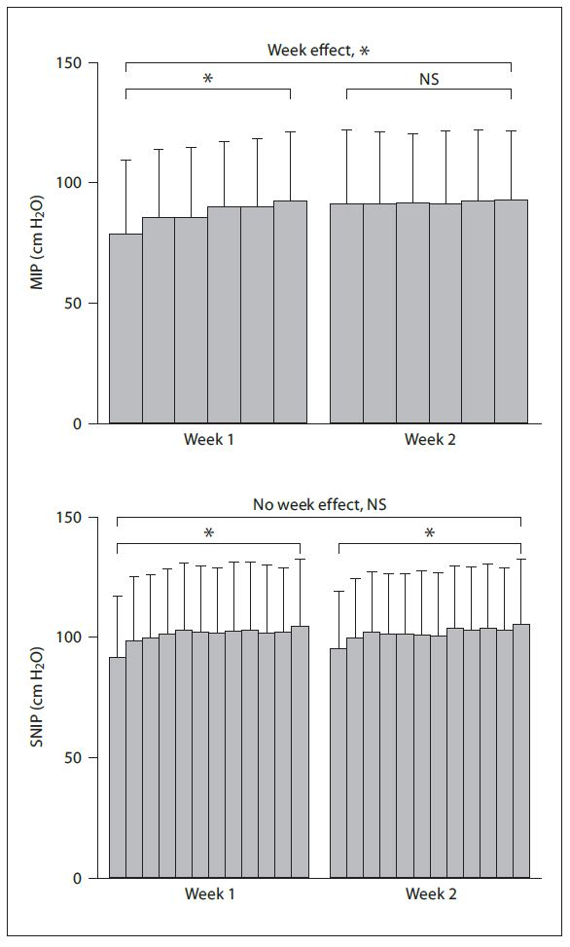
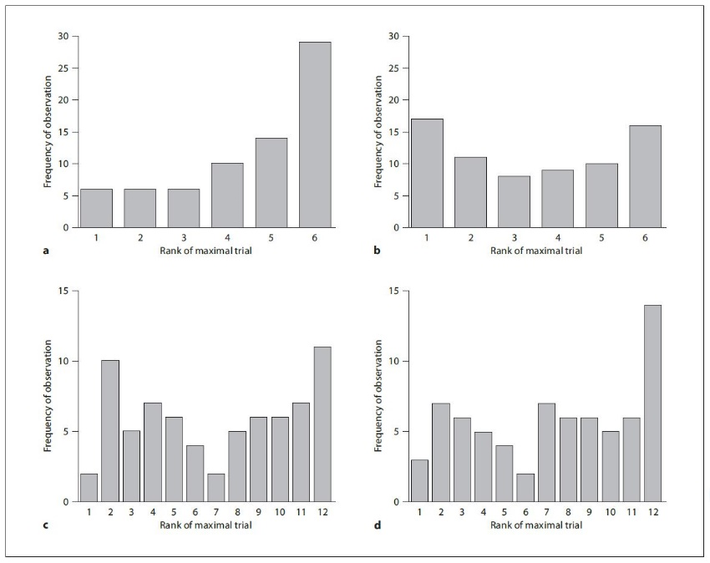
Comparison of MIP and SNIP
Learning effects and reproducibility
71 study subjects performed MIP and SNIP during
2 sessions one week apart.
1st week
2nd week
Trial effect
Trial effect NS V
Learning effect
p=0.0008 in MIP
4.5 + 1.7 trials
to max. value
3.4 + 1.9 trials
to max. value
MIP
MIP
* P < 0.05
7.0 + 3.7 trials
to max. value
7.4 + 3.7 trials
to max. value
Without week effect
p=0.54 in SNIP
SNIP
SNIP
Trial effect
Trial effect
Terzi N, et al. Mouth and Nasal Inspiratory Pressure: Learning Effect and Reproducibility in Healthy Adults. Respiration 210; 80:379-386

Slide 11
Conclusion
The classic “MIP” is difficult to perform for some subjects.
Sniff testing “SNIP” is based on a natural and easy manoeuvre and therefore more suited for most subjects.
SNIP target parameter
SNIPpeak | Sniff nasal inspiratory peak pressure
!
  Recommendation to perform multiple tests of respiratory muscle function (SNIP + MIP) in order to increase diagnostic precision.

