Slide 1

X. Conference
of functional examinations of the lungs
Respiratory muscle strength
Measurement techniques and clinical indications
Hans-Jürgen Smith, Berlin, Germany
Zlín 20th – 21st May 2022

Slide 2
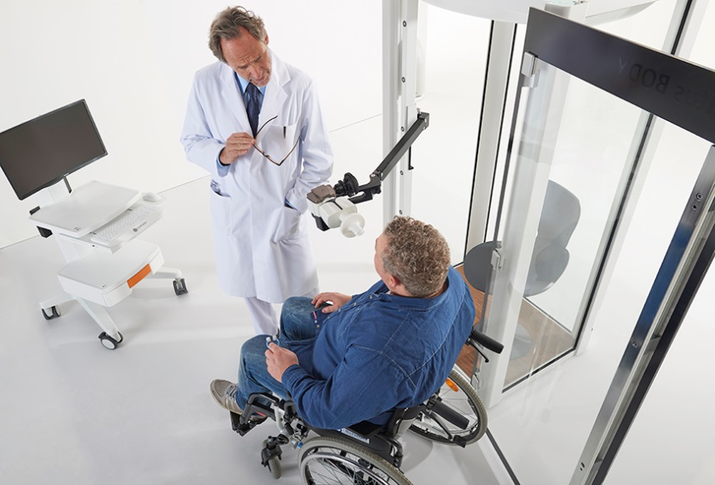
Respiratory muscle strength
Respiratory muscle assessment is required in order to individually tailor and design pulmonary therapeutic decisions, monitoring pharmacologic treatment and rehabilitation programs for the optimization of physical and social performance.

Slide 3
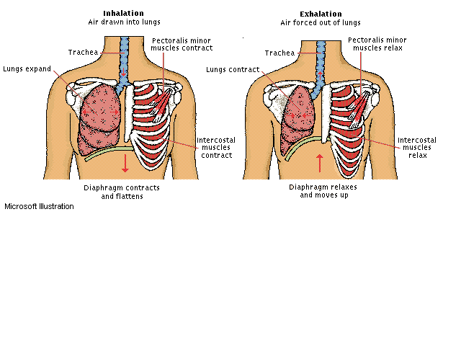
Breathing mechanics
The most important respiratory muscle is the diaphragm
i
The respiratory muscles are used to expand (inhale) and narrow (exhale) the chest.
Ventilation Contraction and subsequent relaxation of chest:
by diaphragm in conjunction with the Pectoralis minor, Intercostal muscles, abdominals.
Spontaneous breathing - active inhalation by means of the inspiratory muscles - passive exhalation by relaxing these muscles

Slide 4
Diagnostics of the breathing pump
Abdominal and thoracic structures
i
Determination of respiratory inspiratory pressures P0.1 and MIP (PImax) for simple non-invasive assessment of the breathing pump.
ATS/ERS-Statement to the diagnostics of the breathing pump
Breathing pump
  Breathing centre
  Conducting nerves
  Thoracic wall and inspiratory muscles
  Bony thorax
ATS/ERS Statement on Respiratory Muscle Testing. Am J Respir Crit Care Med 2002: Vol 166; 518-624

Slide 5
Clinical indications
Fatigue or failure can be muscular, neuro-muscular or neurological
Muscular
  COPD (Atrophy, Dystrophy, Myopathy)
  Chest wall deformities
  Steroid Therapy
  Eaton-Lambert syndrome
  Adjunct to mechanical ventilator weaning
  Assessment of inspiratory muscle training
        Etc, etc…
Neurological
  Surgical Trauma (Anaesthesia)
  Motor Neurone Disease
  Multiple Sclerosis
      Etc, etc…
Association to long-term mortality
  COPD
  Cardiovascular disease
        Etc, etc…
Neuro-muscular
  Amyotrophic lateral sclerosis (ALS)
  Myasthesia gravis
  Chronic hypercapnic respiratory failure (CHRF)
        Etc, etc…
  Spirometry / Lung volumes
  Pattern of restriction
  Reduced FEV₁, FVC but normal FEV₁/FVC
  Reduced FRC, TLC
  Evaluation of patients with
  Respiratory muscle weakness
  Impaired cough
  Retained secretion
    Etc, etc…

Slide 6
Fatigue and overstraining
State of reduced functionality as a result of usage
!
Our respiratory muscles are sized for "continuous performance" but not for "heavy work“
Fatigue depends on the ratio of the current stress (load) to the maximum force (capacity)
Generated inspiratory pressure > 35 - 40% of maximal inspiratory pressure
PI / PImax > 35 - 40% leads to hypercapnia with paCO₂ > 45mmHg
PI / PImax normally < 5%
Causes of respiratory muscle fatigue
  Disorder of the respiratory centre
  Neural Dysfunctions
  Muscular dysfunction
  Neuromuscular dysfunctions
  Impaired transmission of muscle force into alveolar pressure
  Impaired transmission of alveolar pressure into ventilation

Slide 7
Inspiratory muscle function
Expiratory muscle function of less interest
i
Determination of inspiratory pressures P0.1, MIP (PImax)
for simple and non-invasive assessment of the breathing pump
P0.1: Tidal breathing analysis
Parameter for the neuro-muscular activation of the respiratory system.
Indirect measure of respiratory drive.
MIP (PImax): Relatively independent on Raw and CL, dependent on lung volume.
Is there a limitation of the maximal inspiratory forces?
Is there a elevated use of the inspiratory muscles?
Respiratory capacity: P0.1 in relation to MIP
P0.1 / MIP < 4,5% upper limit of normal ULN
P0.1 / MIP > 20% indicate the risk of ventilatory failure

Slide 8
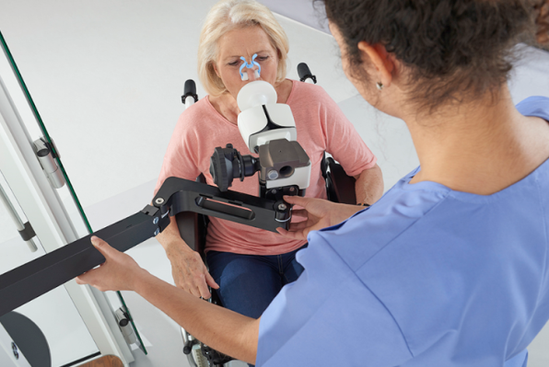
Measurement of P0.1
P0.1 is an effort independent measurement, showing the neuro-muscular ventilator activation (drive) of the respiratory system, which is an important determinant for the work of breathing.

Slide 9
Effective inspiratory pressure P0.1
Tidal breathing (VT) analysis
i
Indirect measure of central respiratory drive.
Measurement of the P0.1 pressure applying a shutter
Mouth occlusion pressure 100 ms after the start of inspiration with an occlusion time of >120 ms
Measurement procedure (Sitting position)
Entry - Normal tidal breathing without specifications
  Start - Mouth pressure of 5 - 10 occlusion manoeuvres per trial within 1.5 min
  - Minimal 2 breaths separate consecutive assessment of P0.1
  - Shutter is activated automatically and randomly
  Quality - Record multiple trials, i.e. at least 3 - 6 and check reproducibility
  Best - Median (average) from all valid trials
!
P0.1max NOT recommended due to high variability!

Slide 10
P0.1
Measurement
5 occlusions
Shutter activated
Shutter released
P0.1
ULN
Predicted line
Upper limit of normal ULN
Predicted line
Spontaneous breathing
FRC stability

Slide 11
P0.1
Result Screen
Record at least 3 trials
Median of accepted trials
Occlusion pressure curves
All trials
Upper limit of normal ULN
Predicted line

Slide 12
P0.1 evaluation
Predicted and clinical interpretation
Mouth occlusion pressure derived at tidal breathing (P0.1)
Predicted values for P0.1 | 0.1- 0.15 + 0.07 kPa
Upper limit of normal (ULN) | 0.3 kPa
Author of predicted values
Adults: Jaeger 1994
Interpretation
Exceeding the upper limit of normal (0.3 kPa) is considered abnormal.
Kabitz HJ et al. Messung der Atemmuskelfunktion. 2014 Deutsche Atemwegsliga, Bad Lippspringe und Dustri-Verlag Dr. Karl Feistle, München – Orlando, ISBN 978-3-87185-493-4

Slide 13
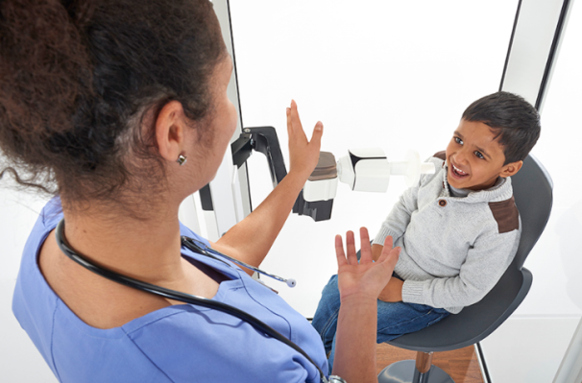
Determination of MIP (PImax)
Many chronic respiratory diseases and neuromuscular disorders are associated with respiratory muscle weakness.
Respiratory muscle strength can be assessed measuring maximal static inspiratory pressure (MIP) non-invasively.

Slide 14
MIP Measurement application
Instructions
i
Determination of maximal inspiratory pressure at the mouth at forced, maximal and sustained inspiration from RV against a closed valve.
Measurement starts by means of normal breathing without regulations in sitting position.
  VT, BF constant, FRC stable
Instruct slow exhalation down to RV.
  Press "Start button“ (F1).
After reaching the plateau at RV, a forced and maximal inspiration against the automatically closed shutter is required.
  Preferably with a defined leak 2mm diameter and 30mm length to prevent glottic closure.
  If possible, inspiratory forcing period longer than 2 s.
  On average, the maximum pressure is reached after 1.5 s.
If possible, record 5 manoeuvres or more, preferably with a pause in between.
  The maximum inspiratory pressure MIP often is reached not until the 5th trial.

Slide 15
MIP measurement application
Parameters
i
ATS/ERS: 3 manoeuvres, maximum values ​​< 20% difference
Intraindividual coefficient of variation < 10% (~7%).
Maximal static inspiratory pressure MIP (PImax)
Germany: Peak pressure MIPpeak
  Simple procedure
  Simple evaluation
  Directly comparable to SNIP (Sniff Nasal Inspiratory Pressure)
International: Maximal inspiratory pressure sustained
across 1 s–plateau MIPsus
  Peak pressure approximately 15% higher than plateau
  Identical reproducibility, high correlation
Other: Average inspiratory pressure MIPavg
  Not recommended because of variability
Pressure [kPa]
16
12
8
4
MIPpeak
MIPsus
MIPavg
Time [s]

Slide 16
MIP (PImax)
Measurement
Application
Lower limit of normal (LLN)
Predicted line
Peak
Manoeuvre
Trials
Predicted line
Lower limit of normal (LLN)
Spirogram

Slide 17
MIP results
Screen report
Median
Trials
Predicted line
Lower limit of normal (LLN)
Trials
Predicted line
Lower limit of normal (LLN)

Slide 18
MIP evaluation
Predicted values and clinical interpretation
Maximal static inspiratory pressure MIP (PImax)
< 60 years | Female | Male
Mean [kPa] | 8.5 | 11.5
Lower limit of normal [kPa] | 4.0 | 5.5
Exclusion of a relevant muscle weakness [kPa)] | > 7.0 | > 8.0
Authors of predicted values
Children: Stefanutti
Adults: Karvonen
Interpretation
Measures below the lower limit of normal (4 or 5.5 kPa) are considered abnormal.
!
MIP (PImax) relatively independent of Raw and Cl;
dependence on absolute lung volume!
- Kabitz HJ, et al. Messung der Atemmuskelfunktion. 2014 Deutsche Atemwegsliga, Bad Lippspringe und Dustri-Verlag Dr. Karl Feistle, München – Orlando, ISBN 978-3-87185-493-4
- Karvonen J, et al. Measurement of Respiratory Muscle Forces Based on Maximal Inspiratory and Expiratory Pressures. Respiration 1994; 61: 28-31

Slide 19
Respiratory capacity
P0.1 / MIP - index for assessing respiratory capacity
i
Assessment of ventilatory demands and muscle ventilatory reserve.
Respiratory capacity (P0.1 / MIP)
Independent from lung volume!
Estimation of the momentary strain on the inspiratory respiratory muscles.
Clinical interpretation of respiratory capacity
Exceeding the upper limit (> 4.5%) is considered abnormal .
Classification of P0.1/MIP [%]
0 - 4,5% | Normal
> 4,5 - 20% | Significantly increased
> 20 - 30% | Highly increased
Author of predicted values
Adults: Jaeger 1994
Kabitz HJ et al. Messung der Atemmuskelfunktion. 2014 Deutsche Atemwegsliga, Bad Lippspringe und Dustri-Verlag Dr. Karl Feistle, München – Orlando, ISBN 978-3-87185-493-4

Slide 20
Final Report
Print-out

Slide 21
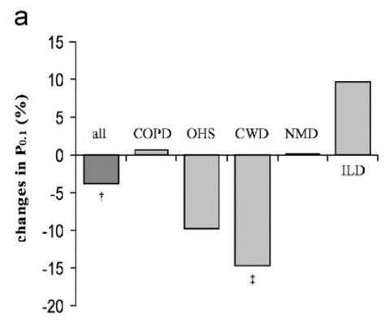
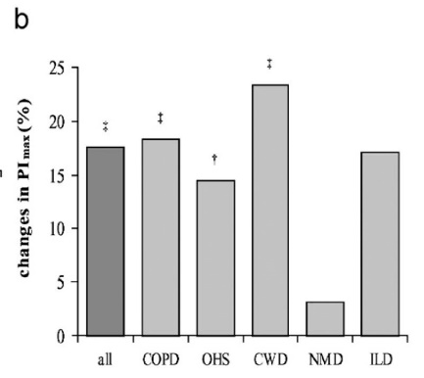
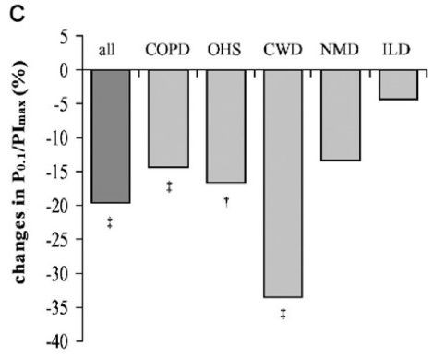
Prognostic value of respiratory muscle function
Mouth occlusion pressure in patients with chronic ventilatory failure
Study population |  | 464
COPD |  | 227
Obesity-hypoventilation syndrome | OHS | 109
Chest wall diseases | CWD | 75
Neuromuscular disorders | NMD | 39
Interstitial lung diseases | ILD | 14
Follow-up visit 5.8 (3.9; 7.6) months after initiation of non-invasive ventilation in 396 patients.
P0.1 (%)
PImax (%)
P0.1/PImax (%)
‡
‡
‡
†
‡
†
†
‡
‡
‡
Percentual changes in P0.1, PImax and P0.1/PImax (median) at follow-up in the different disease groups
† p<0.01; ‡ p<0.001
Budweiser S, et al. Prognostic value of mouth occlusion pressure in patients with chronic ventilatory failure. Respiratory Medicine 2007: 101; 2343-2351

Slide 22
MEP measurement
With less clinical relevance
i
Determination of maximal expiratory static pressure at the mouth at maximal and sustained exhalation from TLC against a closed valve.
Maximum static expiratory pressure MEP (PEmax)
  MEP is generated through the abdominal and intercostal muscles.
Measurement procedure
Start - Normal tidal breathing without specifications.
  Manoeuvre - Full inhalation to TLC and maximal exhalation of possibly 2 seconds.
  Shutter is activated automatically.
  Quality - Record multiple trials, i.e. at least 3 - 6 and check reproducibility.
  Best - Median (average) from all valid trials.

Slide 23
Summary
Respiratory muscle strength
Respiratory muscle weakness has serious clinical consequences.
The assessment of respiratory muscle function and the detection of respiratory muscle weakness has importance in many diseases, including lung diseases, neuromuscular, systemic or cardiologic diseases.
!
Properly performed assessment of respiratory muscle function should be possible in any well-equipped lung function laboratory.
Parameter | Synonym | Description
P0.1 |  | Central respiratory drive
MIP | PImax | Maximal static inspiratory pressure
P0.1/MIP | P0.1/PImax | Respiratory capacity
MEP | PEmax | Maximal static expiratory pressure

